Slide 1
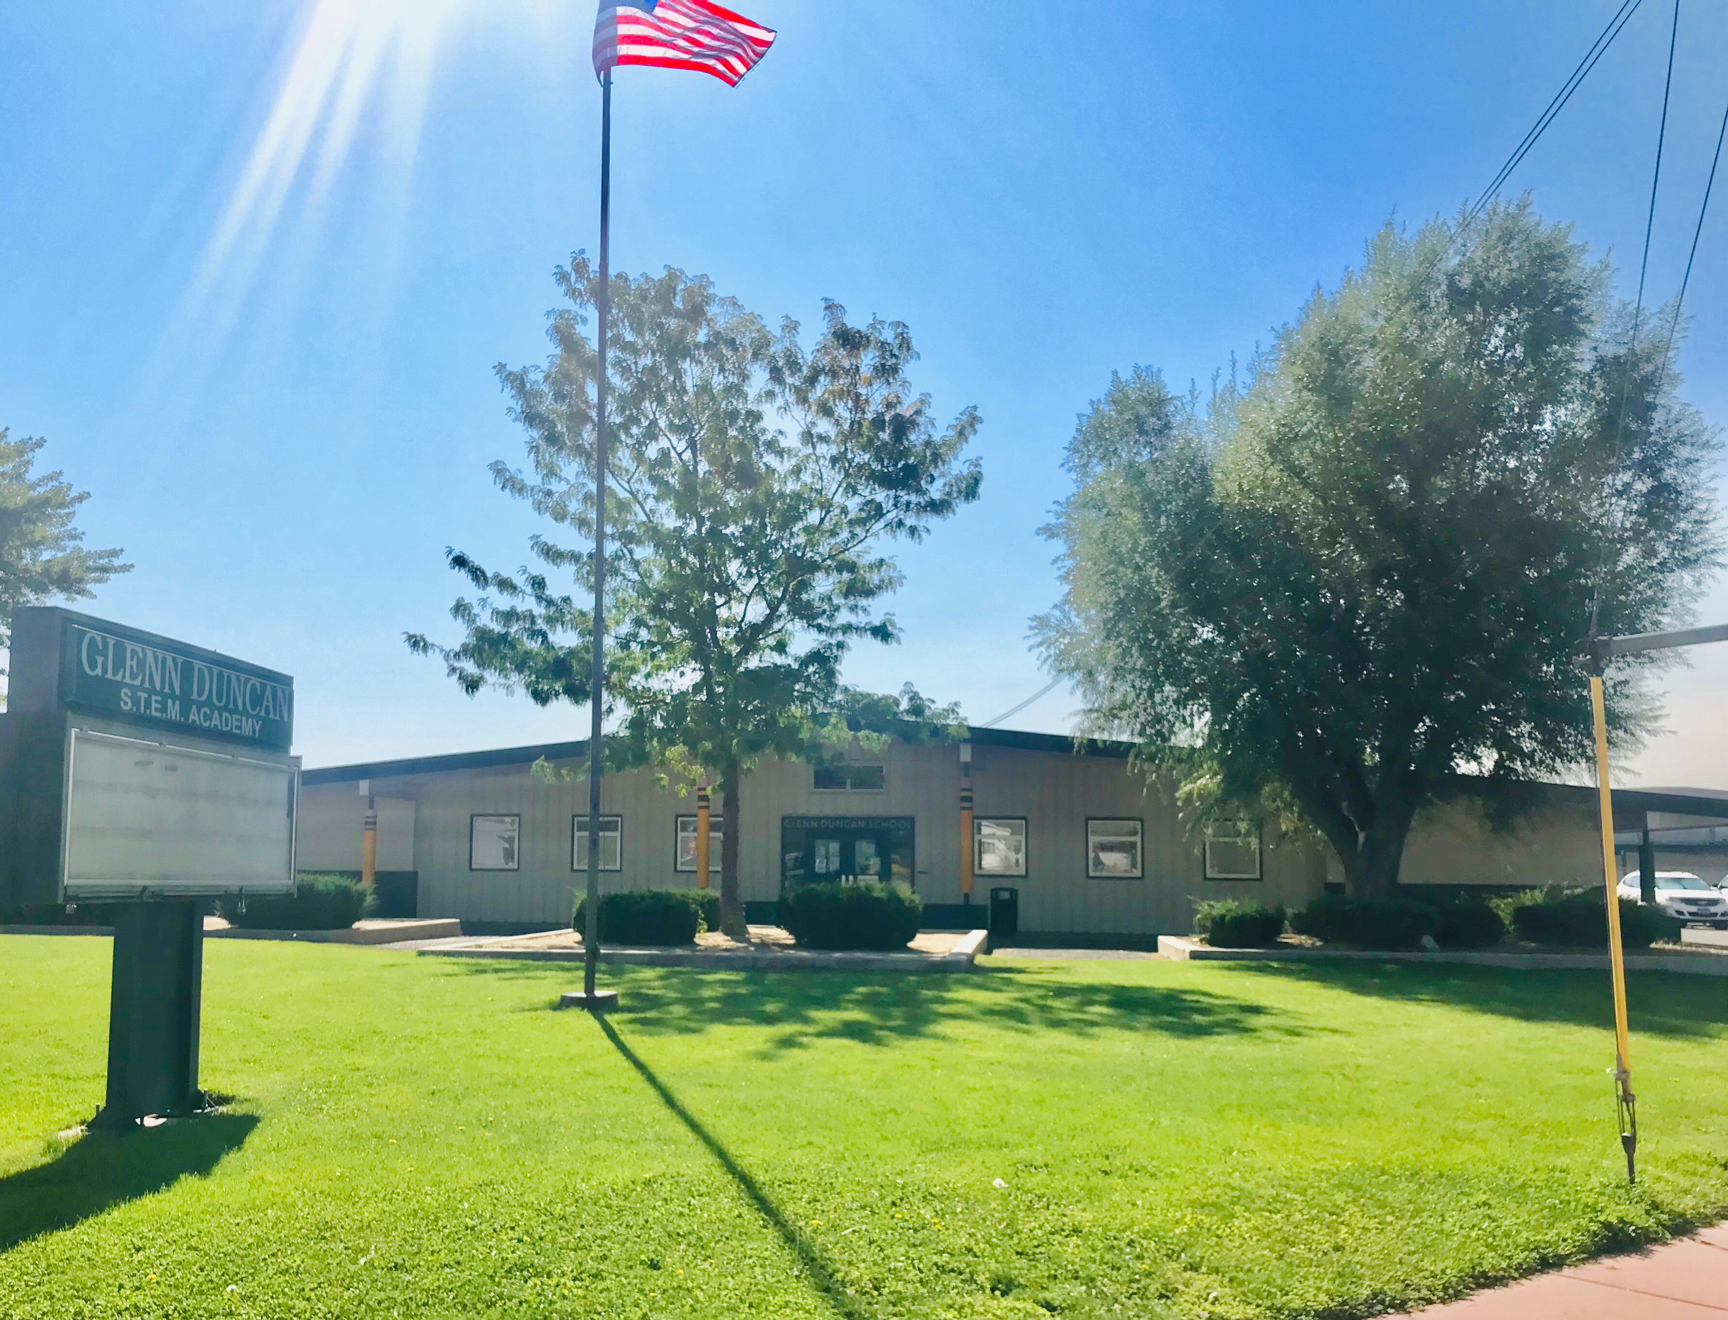
Duncan Back-to-School Night & Annual Title I Meeting
What Every Family Needs to Know!
September 8th, 2020

Slide 2
Duncan Updates- Principal – Mrs. Weir New Assistant Principal – Mrs. Walker

Slide 3
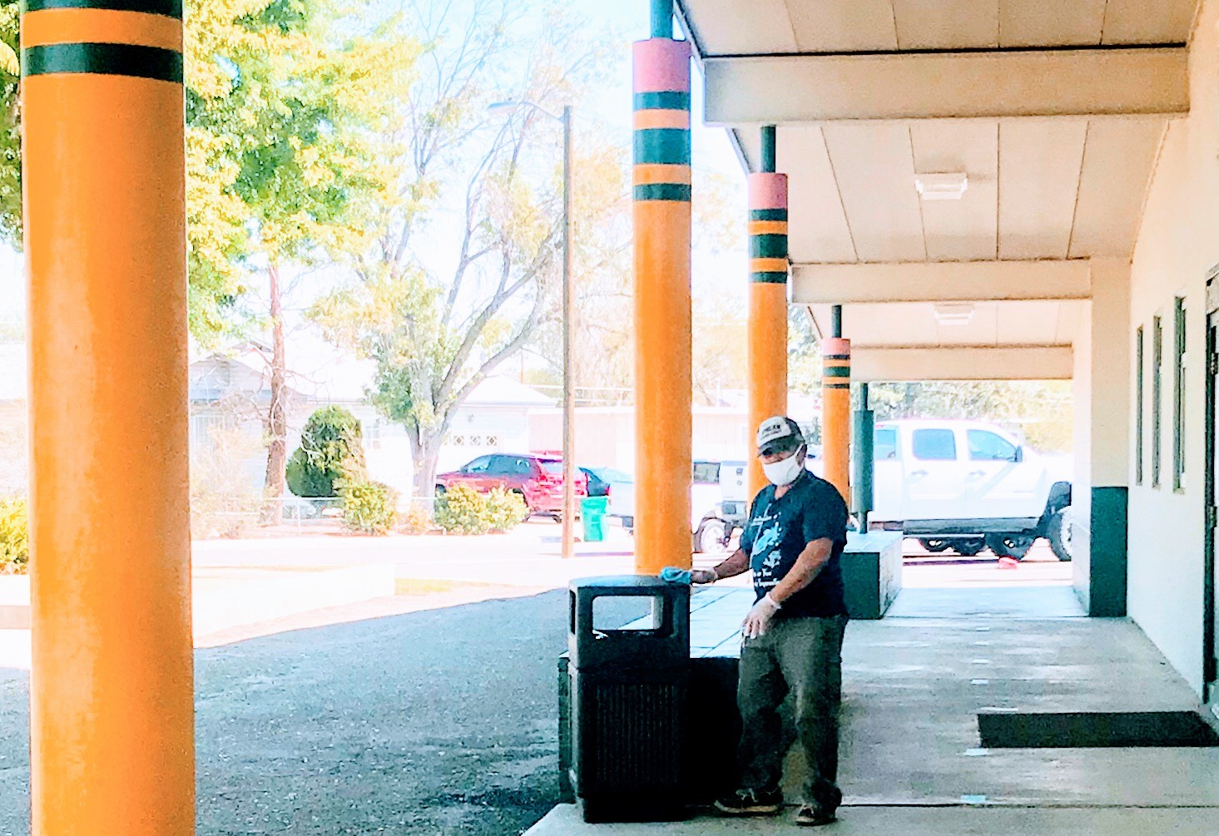
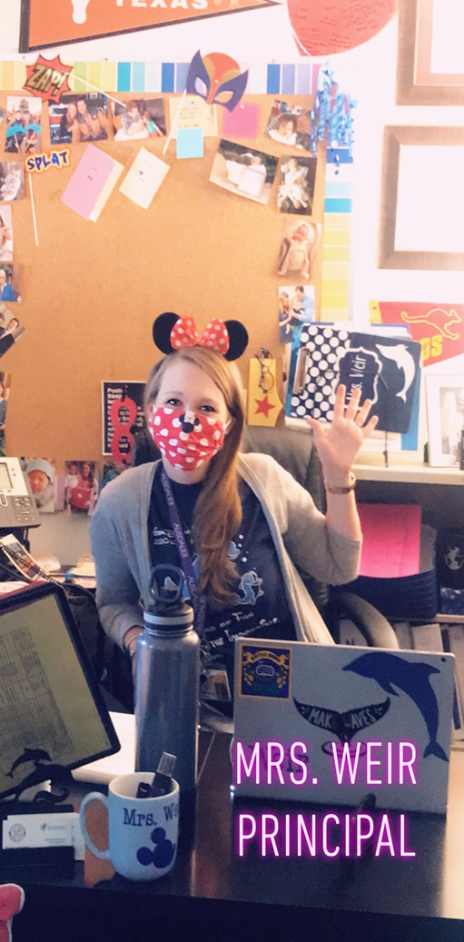
2020 UpdatES
Thank you in-person students and families for wearing masks. Remember, we are practicing the Duncan 3Ws:
Watch your distance!
Wear your mask!
Wash your hands!
Reminders:
No backpacks – only lunchboxes and small purse or pouch that can be kept inside of desk. This helps to reduce cross-contamination between students. Keep your backpack at home with supplies needed for school (like a locker).
Distance Learning schedules (on brightly colored cardstock) with user names and passwords will be sent home this week for in-person students to ensure you can follow along with the learning day as much as possible.
Distance Learner Materials Pick-Up – This Friday, Sept. 11th
Last Names A-G- 10-10:30
Last Names H-L – 10:30-11:00
Last Names M-Q- 1:00-1:30
Last Names R-Z-1:30-2:00

Slide 4
Additional Duncan Updates…
Distance Learning – GREAT WORK SO FAR!
Weekly grades are required
Reports Cards will still be issued
Daily progress on assignments is required for attendance
More tech is coming soon!
In-Person –
Self-screen daily
When STs are excluded, STs attendance is still recorded and make-up work is required
Excluded STs are welcome to ZOOM-in or join TEAMS live sessions for grade level.
Class DoJo – up-to-date information from teachers and school! Rosters and teachers will shift throughout the year based upon enrollment.

Slide 5
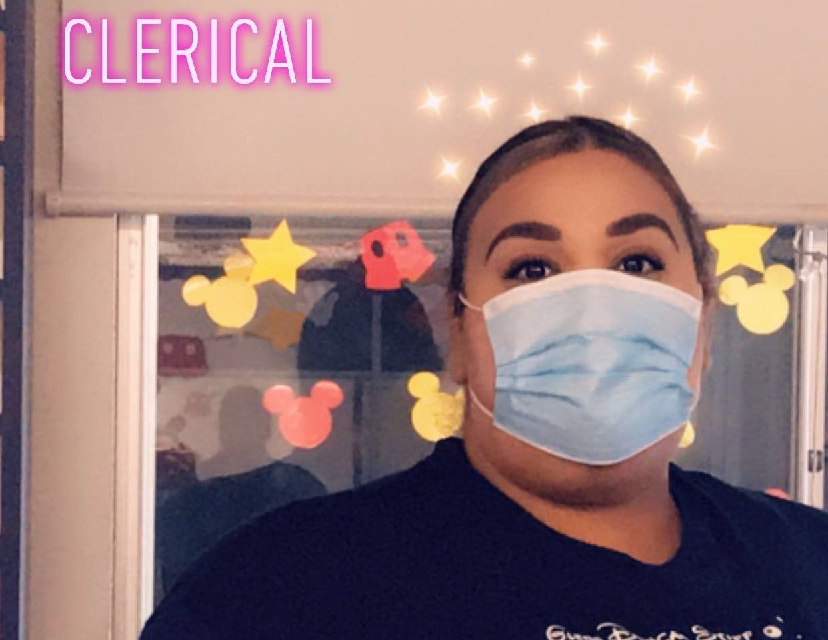
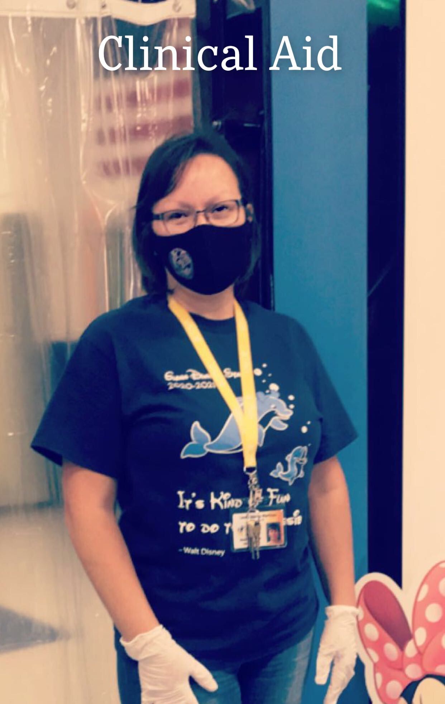
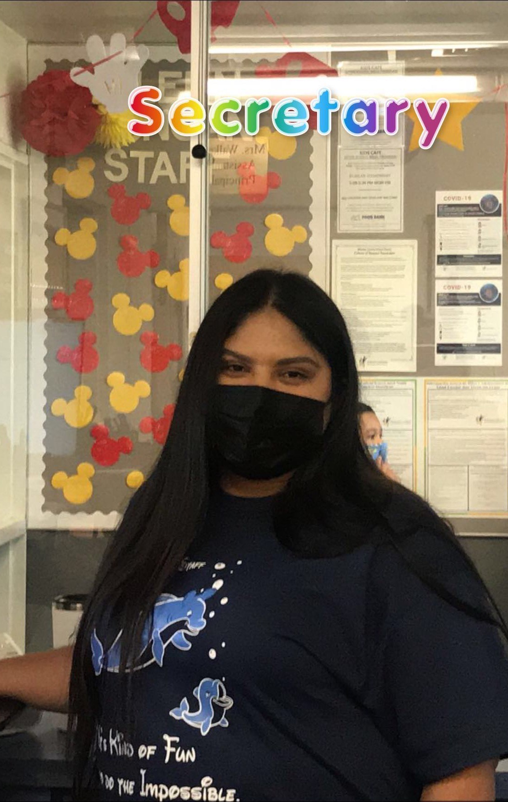
Additional Duncan Updates…
House Colors for in-person and Distance Learners– last Friday of the month – uniform pants still required.
Ausdauer – Purple
Inspirasi – Orange
Pololei – Blue
Valor - Yellow
Lunch and recess times have changed!
11:00 – 11:45 – K and 1st Lunch and Recess
11:30 – 12:00 – Pre-K Lunch
11:30 – 12:15 – 2nd and 3rd Lunch and Recess
12:00 – 12:45 – 4th and 5th Lunch and Recess

Slide 6
Counseling + Communities in Schools Supports Apoyos de Consejería + Communities in Schools

Slide 7
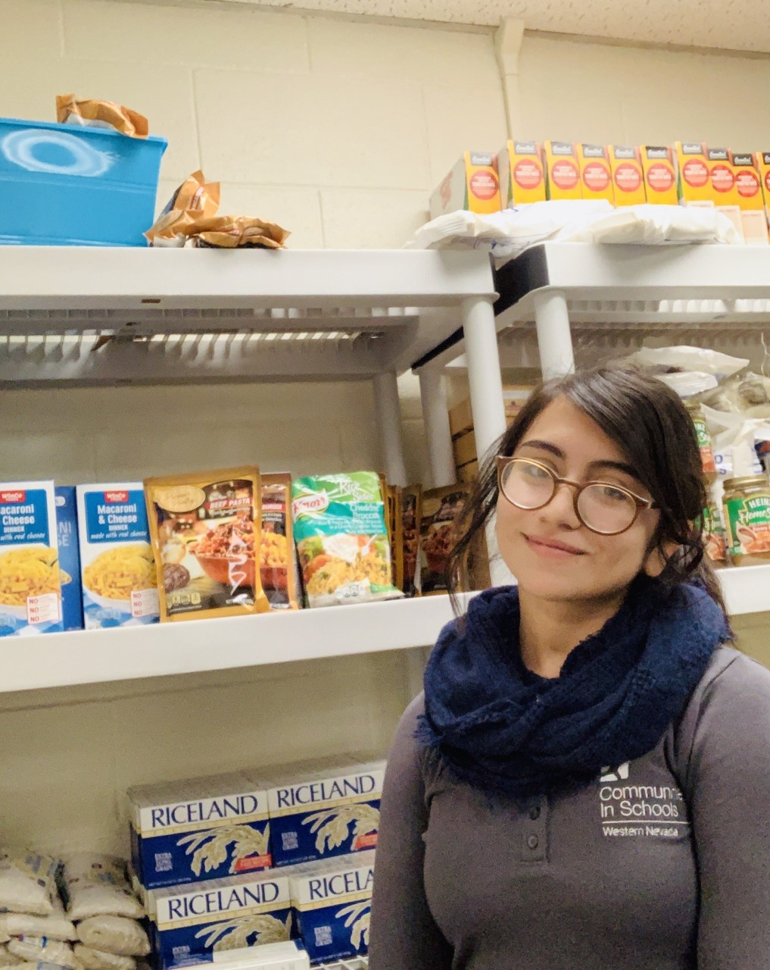
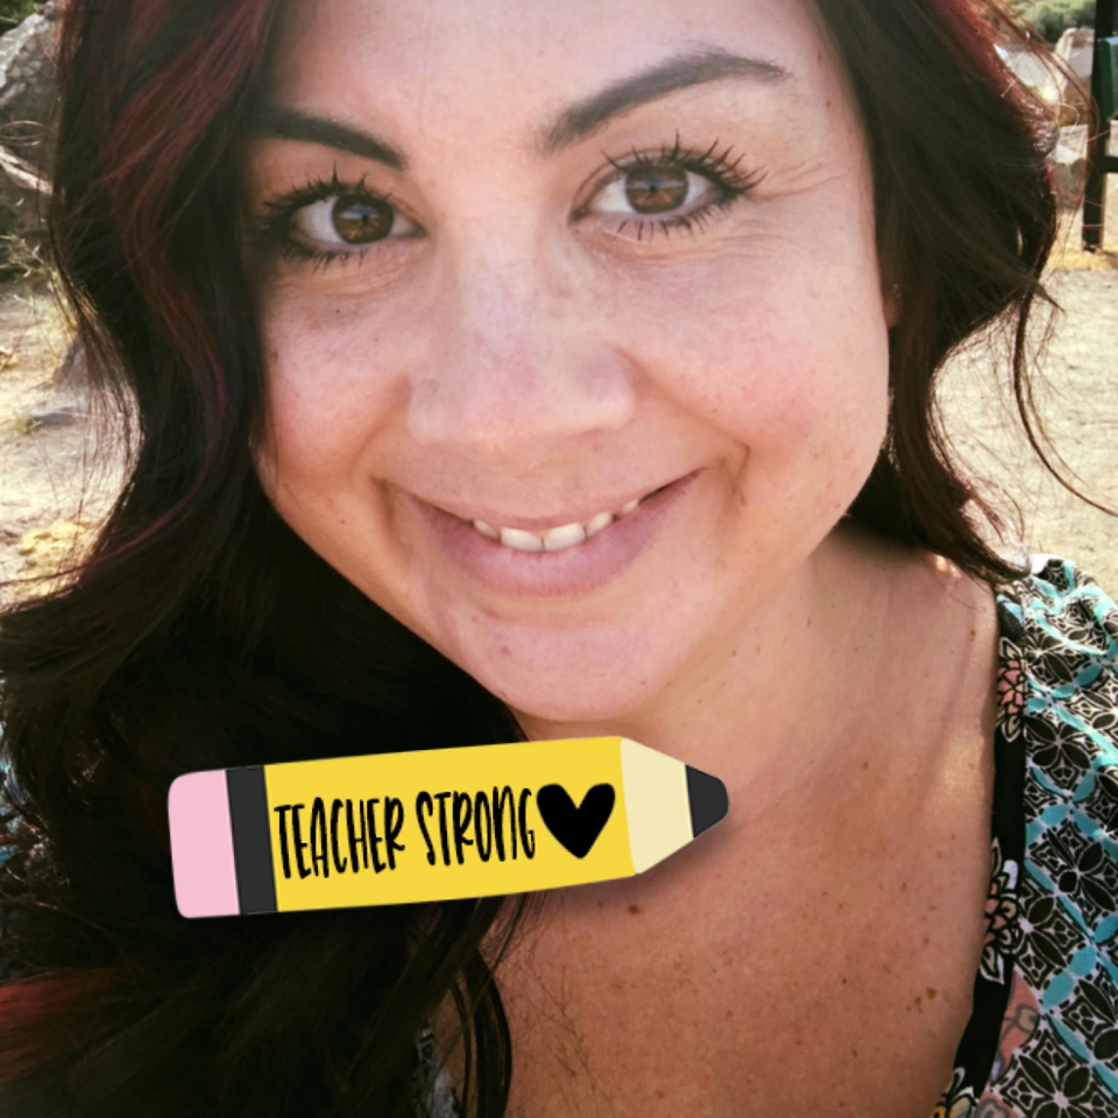
Who are we? ¿Quienes somos?
School Counselor
Consejera Escolar: Beth Stoker
Communities in Schools
Coordinadora de Sitio : Carolina Juarez
Provide Direct Services to Students and Families:
-Tier 1 Guidance (Sanford Harmony, Kelso‘s)
-Tier 2 Small Groups (Zones of Regulation)
-Tier 3 Individual (Mobile Crisis, SafeVoice)
Proporcionar servicios directos a estudiantes y familias: - Orientación de nivel 1 - Nivel 2 Grupos Pequeños - Nivel 3 Individual
Provide In-Direct Service: Community Referrals and Collaboration with CIS
Proporcionar servicio directo: Referencias comunitarias y colaboración con CIS
Work with students to help them achieve A/B/C goals
Trabajo con estudiantes para ayudarlos a alcanzar las metas de asistencia, comportamiento y progresión de los cursos
Bring resources from the community to Glenn Duncan
Traer recursos de la comunidad a Glenn Duncan
Extra person students, parents, families can check-in with
Persona adicional que los estudiantes, los padres y las familias pueden hablar con

Slide 8
What resources does Glenn Duncan offer? ¿Qué recursos ofrece Glenn Duncan?
Social-Emotional Needs Side
Lado de las necesidades socioemocionales
Other Needs
Otras necesidades
One-on-one check-ins with students
Juntas individuales con estudiantes
Small group settings
Juntas de grupos pequeños
The counselor provides guidance lessons on topics like: anxiety, stress etc.
La consejera brinda lecciones sobre temas como: ansiedad, estrés, etc.
School-wide efforts: SEL Kits are coming out soon for our Distance Learners
Esfuerzos en toda la escuela: los kits de SEL saldrán pronto para nuestros estudiantes a distancia
Food Pantry: Fridays from 9:15-10:15 AM
Despensa de alimentos: viernes de 9:15-10:15 AM
Clothing closet (shoes, socks, underwear etc.)
Ropa (zapatos, calcetines, ropa interior, etc.)
School supplies
Útiles escolares
Hygiene closet
Productos de higiene
Resource referrals
Referencias de recursos

Slide 9
We’d love feedback from you! ¡Nos encantaría recibir sus comentarios!
We will be sharing these on Glenn Duncan’s Class Dojo
Compartiremos estos en el Class Dojo de Glenn Duncan
Community Needs Assessment Form(Evaluación de las Necesidades de la Comunidad): link
Parent referral form (Formulario para padres): link
If you ever have a concern, please feel free to reach out to one or both of us at (Si tiene una inquietud, no dude en comunicarse con nosotros a):
DOJO LINK: https://www.classdojo.com/invite/?c=C2QW8F3
Counselor/Consejera Beth Stoker: bstoker@washoeschools.net
Or 775-333-5190 ex. 5
CIS Carolina Juarez: carolinaj@cisnevada.org
or (775) 476-2867

Slide 10
Title I Program
Purpose
School participation

Slide 11
Title I provides federal funding to schools to help students meet the challenging State academic standards
PURPOSE
Title I funds are targeted to schools with high numbers of children from low-income families.
Title I is part of the Every Student Succeeds Act and provides about $15 billion per year in federal aid to local schools across the United States.
More than 55,900 public schools receive Title I funds.
Title I serves more than 26 million children.
US Department of Education
Title I, Part A
Budget Tables
Notes:
Purpose of Title I

Slide 12
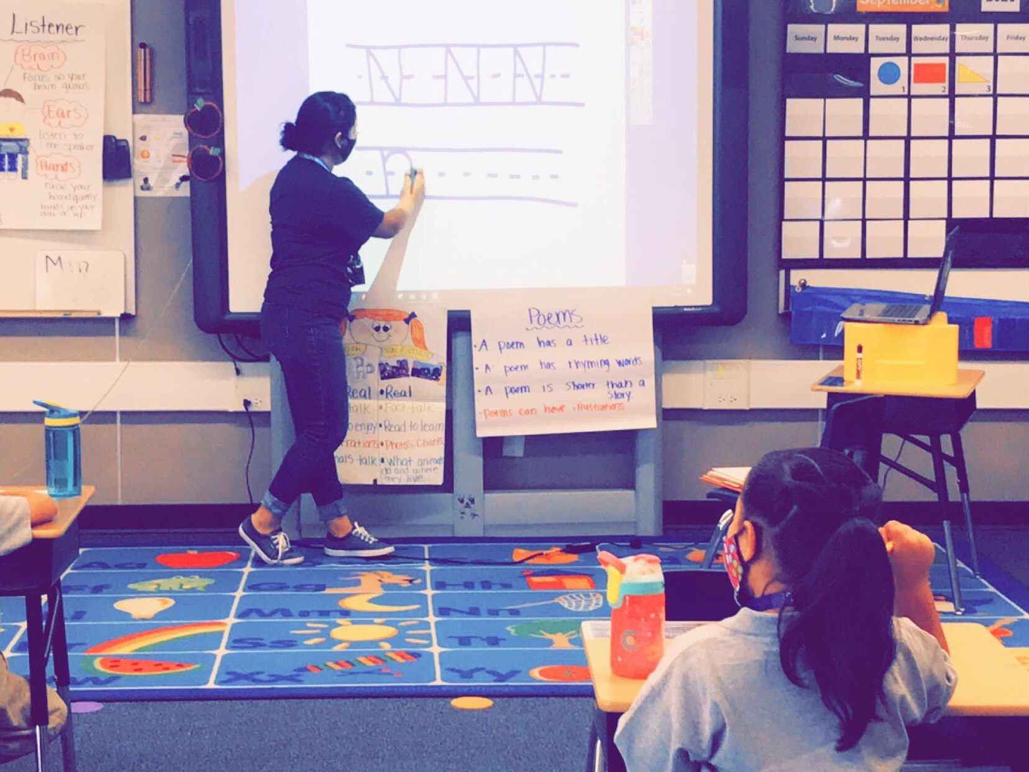
PARTICIPATION
Schoolwide Basis - Funds used to serve all students in order to increase academic achievement.
Use of Title I funds
Improve school’s entire educational program
Provide additional assistance to all students who experience difficulties in meeting the State’s performance targets
Notes:
To be a “schoolwide” school the school must have a free/reduced lunch count of at least 40%, collect and analyze data that affects student achievement, and must develop a comprehensive site plan (School Performancy Plan) and annually review its effectiveness.

Slide 13
Assessments
Required Assessments for Title I
State Assessments
Reading (ELA) and math annually for grades 3-8 (Smarter Balanced Assessment Consortium – SBAC), Science for 5th
Other:
Students who are English Learners (EL) have tests of English academic proficiency.
Measure listening, speaking, reading, and writing skills in English (ACCESS for ELLs)
Notes:
These are required by Title I; list does not include all the state-law-required assessments, i.e., MAP for NVKR, etc.

Slide 14
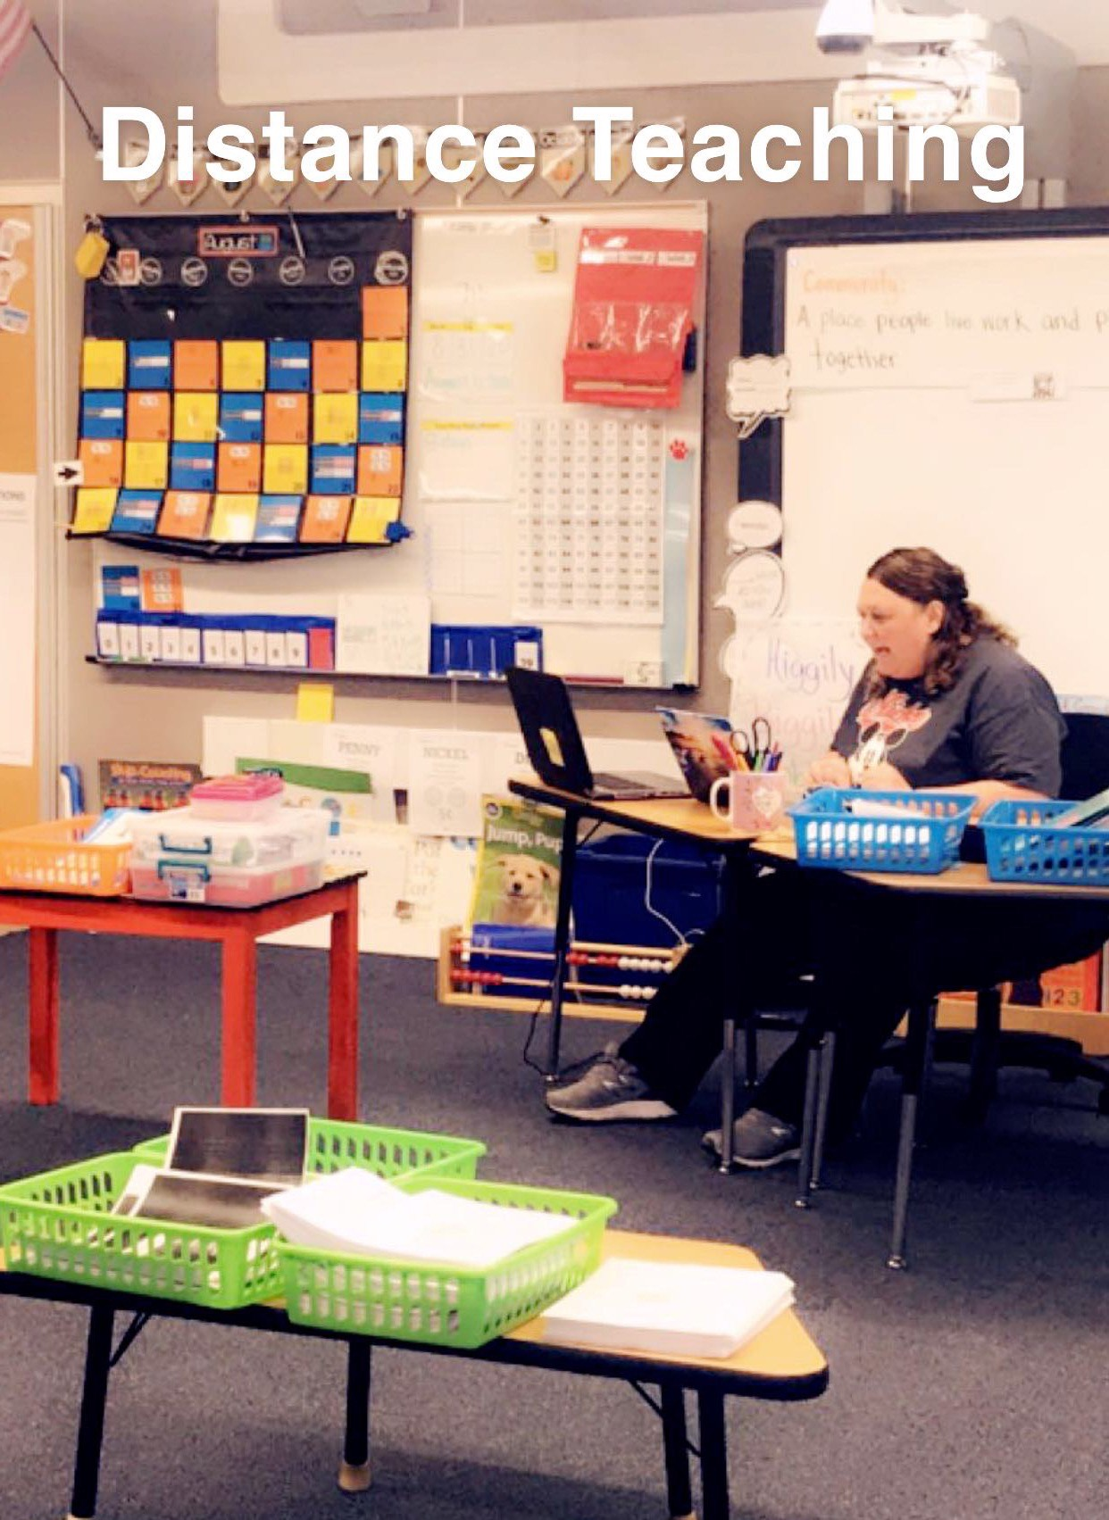
Program Funds
Allocated so schools with the most low income students get the most funding
Allocated from the highest percentage down
This chart is an example of four elementary schools and the percentage of students who receive free or reduced lunches.
Notes:
Washington School would receive a higher amount of Title I funds as it has the largest percentage of students receiving free/reduced lunch. Lincoln and Obama would not be eligible to receive schoolwide Title I funds as their FRL rates are too low. (For your own information: Rate when schools can become eligibile to receive schoolwide funds is 40%, WCSD funds down to high 58% percent.)

Slide 15
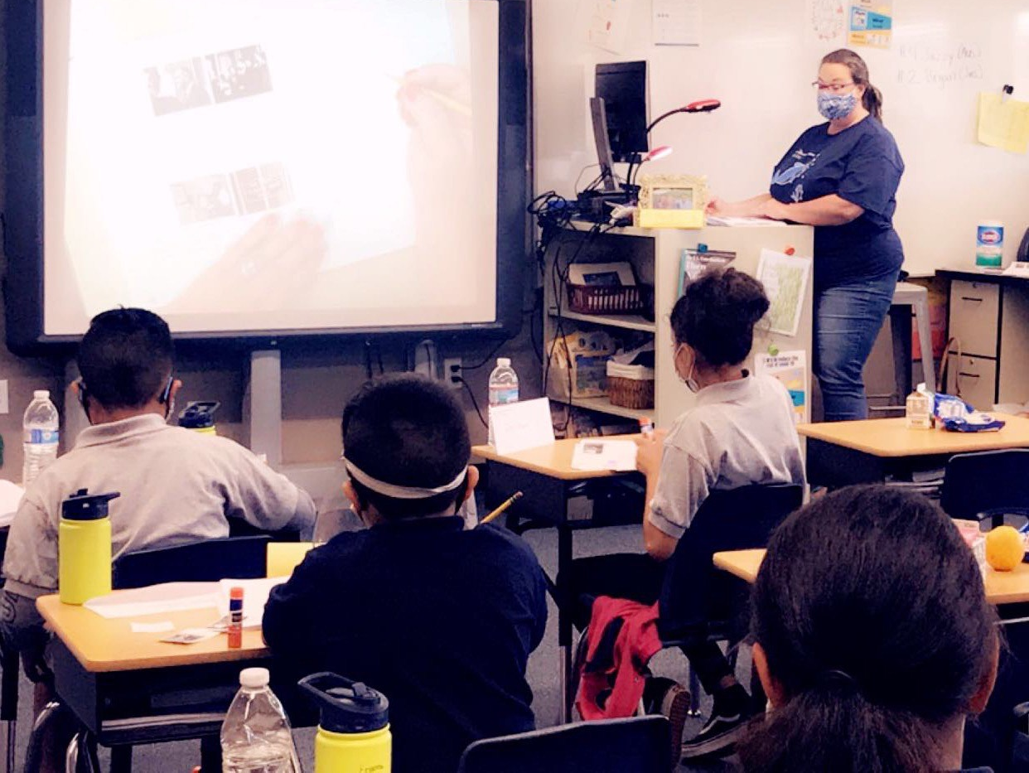
PROGRAM FUNDS
Amount of funds available for this year
$177,560
Title I budget consists of:
Assistant Principal
Communities in Schools Professional (Ms. J)
General Supplies
FACE Liason (Mrs. Celia)
Notes:
Tailor this to your school. Can also show parents how to get to School Performance Plan Budget page.

Slide 16
District Policy – family engagement
Governing Practices
Welcoming all families.
Communicating effectively.
Supporting student well-being and academic success.
Speaking up for every child.
Sharing power.
Collaborating with community.
Building the capacity of staff to engage families.
Board Policy 5200
Notes:
1. Parents and families are active participants in the life of the school, feel welcome, valued and connected to each other.
2. Families and staff engage in regular, authentic, two-way, meaningful communication about student learning.
3. Families and school staff collaborate to support student learning and healthy development both at home and at school.
4. Families are empowered to be advocates for their own and other children , ensuring that students are provided equitable access to learning opportunities.
5. Families and school staff are equal partners in decisions that affect children and families.
6. Families and school staff collaborate with community members to connect students, families, and staff to expanded learning opportunities, community services, and civic participation
7. Staff have access to professional learning opportunities that increase their cultural competency and provide practical, research-based strategies that improve their ability to effectively partner with families.

Slide 17
School-Parent Compact
Every Title I school must have a School-Parent Compact, developed with and approved by parents.
Compacts describe how the school and parents share responsibility for student achievement.
Nevada law requires the use of the Educational Involvement Accords as the school-parent compact.
Elementary schools - reviewed during parent/teacher conferences
Watch for the link coming soon from Mrs. Celia (FACE liaison) and Ms. J (CIS) for additional input on our programming and parent support events for this year.

Slide 18
educator Qualifications
Teachers must meet Nevada certification requirements
Paraprofessionals are highly qualified
Timely notice given if a student has been taught for 4 or more weeks in a row by a teacher who does not meet the State certification requirements, i.e., long-term substitute.

Slide 19
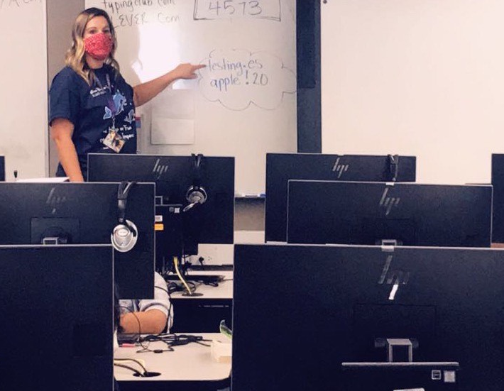
Parents’ right-to-know – school level
Information on State and local assessments
Right of parents to become involved in the school’s programs and how to do so
Subject matter assessed
Purpose of the assessment
Volunteering
Flexible meetings
Monthly meetings
Other
Notes:
Besides the information provided in the previous slides, parents can request information on any of these items and the school has to provide it in a timely manner. Report cards quarterly. Information on State and Local Assessments – parents can request more information on state and local assessments, i.e., practice tests, MAP, Brigrance, ACT, etc. What the participation policy is…

Slide 20
Parents’ right-to-know – district level
District report card
English Learner (EL) placement
State or District policy on student participation in mandated assessments
Overall student achievement
Achievement by category
Graduation rates
District performance
Gender
Etc.
Achievement by school
Notes:
These are items not specifically stated in previous slides.

Slide 21
CSI-TSI-ATSI
CSI – Comprehensive support and improvement
TSI – Targeted support and improvement
Atsi – additional targeted support and improvement
No updated SBAC scores from 19-20 school year
12% Exited ACCESS – vs. 8% in 18-19.
Strong growth in ACCESS Writing components 1st – 5th
TNTP – The New Teacher Project – Partnership Continued
Reading Goal 20-21 – Essential Standards and Increased Academic Language
Math Goal 20-21 – Continue to Increase Conceptual Understanding
Parent/Community Goal – Continued partnership throughout the year and increased digital literacy.

Slide 22
Tonight’s Schedule
5:30 – Kinder
5:45 – 1st
6: 00 – 2nd
6:15 – 3rd
6:30 – 4th
6:45 – 5th

Slide 23
Questions?

